Slide 1





BE Project Presentation On
Smt. Kashibai Navale College Of Engineering, Pune
Department Of Computer Engineering.
Cross-Platform Application for Major Project
Management and Tracking
Presented By-
Pranoti Namdas Aditya Nirmal Omkar Patil Yash Patil
C42241 C42243 C42249 C42250
Guided by
Prof. V. S. Paithankar
A. Y. 2024 - 25

Slide 2

Cross-Platform Application
for Major Project
Management and Tracking
Welcome! Today, we're exploring the development of a powerful, cross- platform application for managing and tracking complex projects. Designed for teams of all sizes, this application streamlines workflows, promotes collaboration, and ensures successful project completion.

Slide 3
Introduction
In an era characterized by rapid technological advancements and dynamic market conditions, effective project management has emerged as a crucial determinant of organizational success. Large-scale projects, often complex in nature and involving multiple teams, present significant challenges that traditional project management tools struggle to address. This limitation often results in inefficiencies, communication breakdowns, and missed deadlines, hindering overall productivity.
To overcome these challenges, we propose the development of a Cross-Platform Application for Major Project Management and Tracking, designed using Flutter. This application aims to provide a streamlined and intuitive solution for managing projects across various devices, including desktops, tablets, and smartphones. By enabling real- time updates, seamless task allocation, and enhanced collaboration among team members, the application seeks to foster a more efficient and responsive work environment.

Slide 4
Motivation
Complex Projects: Managing large-scale projects requires an efficient tool to handle multiple teams and tight deadlines.
Limitations of Existing Tools: Traditional project management solutions often lack flexibility and real-time capabilities, leading to inefficiencies.
Real-Time Collaboration: Seamless interaction among team members is critical for project success.
Cross-Platform Accessibility: Users need access to management tools across various devices to enhance productivity.
User-Friendly Design: An intuitive interface can improve user adoption and satisfaction.
Informed Decision-Making: Analytics and reporting features provide better visibility into project progress.
Scalability: Organizations need solutions that can grow with them without significant costs.
Competitive Edge: Innovative project management solutions enable organizations to respond effectively to market demands.

Slide 5
Literature Survey
Sr. No | Title | Methodology | Author
1 | ERP on Cloud: Implementation Strategies and Challenges | This paper aims to discuss about the ERP implementation strategies and challenges in a Cloud Environment. ERP is important business software used in all major enterprises and is a useful tool to coordinate the available resources, information and activities to complete the business process. Its importance in an enterprise has led to an increased demand of the ERP software. ERP in CLOUD environment, will help Medium and small enterprise to use it as per their requirements and will lead to more efficient business process. | P. Appandairajan, Z. Ali Khan, and M. Madiajagan
2 | Cloud Enterprise Resource Planning Implementation: A Systematic Literature Review of Critical Success Factors | This paper investigate and identify the critical success factors (CSFs) and the organizational, environmental, technological and individual characteristics that impact implementation of cloud ERP systems. This study provides new insights into cloud ERP adoption, its CSFs and offers more clarity to information technology (IT) practitioners into the characteristics that may impact cloud ERP implementation. | S. Tongsuksai, S. Mathrani, and N. Taskin
3 | Open-source ERP systems: an overview | This paper reviews the current state of ERP functionalities and technologies in open-source software (OSS), suitable for small-to- medium enterprises (SMEs). Sixteen systems are reviewed by a set of criteria, such as programming language, database management systems (DBMS), and offered functionalities. | T. Mladenova

Slide 6
Sr. No. | Title | Methodology | Author
4 | Integrating Cloud ERP Systems with New Technologies Based on Industry 4.0: A Systematic Literature Review | This paper presents a comprehensive literature review of current research on integration of cloud ERP systems with new technologies in the Industry 4.0 environment. This uses Internet-of-things (IoT) platforms and new technologies in order to provide integrated connectivity via the Internet. The purpose of this strategy is to enhance automation and communication in businesses. | S. Tongsuksai, and S. Mathrani
5 | Using Firebase Cloud Messaging to Control Mobile Applications | The proposed system is a new framework for controlling mobile applications using Firebase Cloud Messaging (FCM), supported by Google. It allows sending notifications through data messages that can alter app behavior. This system manages multiple Firebase applications simultaneously and stores data messages in a local database. It operates as a REST client, sending JSON format data messages, which can be manually created or sourced from external environments. These messages can target specific applications or user groups using the "subscribe topic" feature, enhancing app control and flexibility | Mohamed Mokar, Sallam Fageeri, Sai Fattoh
6 | An Innovative Project Management Syste m | This paper describes an innovative web based Project Management System that adds to the set of established tools of project management. The system is designed to handle a number of very large projects. It is based on robust open source systems and frameworks. In addition to the basic features such as Network Diagram, Critical Path Method (CPM), Program Evaluation and Review Technique (PERT), Work Breakdown Structure (WBS), Gantt Chart etc., the system integrates with Geographical Information System (GIS.) | Alam, S. (2019)

Slide 7
State of Art Evaluation
Aspect | My Project | Existing System (e.g., Trello) | Gap
Cross-platform Development | Single codebase for both Android and iOS ,Windows ,Linux ,Web . | Web-based . | No major gap here; both support cross- platform use.
Task Assignment | Allows Teamleads to assign tasks directly to employees. | Trello allows task assignment using boards/cards. | No significant gap; both allow task assignments.
Project Creation | Projects created by guides, with task delegation. | Trello allows users to create and manage projects. | No major gap in basic project creation.
Tracking Progress | Real-time task and project tracking specific to projects | Trello supports Kanban-style tracking of task status. | Gap: Trello uses Kanban, whereas your app can have custom tracking tailored to education.
Offline Access | Limited offline access through local storage | Limited offline functionality in apps, mostly online. | Our project offers more offline functionality for task access
Role-based Access | Specific roles for each and everyone | Trello has a more general member- based system. | Gap: Our system offers more targeted role-based control specific to educational roles.

Slide 8
Problem Statement
Managing large projects across multiple teams often leads to miscommunication, lack of visibility, and delayed execution. Traditional tools fail to provide real-time coordination, accountability, and efficient task tracking across roles. There is a need for a centralized, cross-platform solution to streamline project management and improve collaboration among managers, team leads, and employees.
Objectives
Streamlined Task Management: To provide a structured framework for assigning, tracking, and updating tasks among team members, ensuring clarity in responsibilities and deadlines.
Real-Time Collaboration: To facilitate seamless communication among project stakeholders through integrated messaging and notification systems, enabling timely updates and coordination.
Cross-Platform Compatibility: To develop a user-friendly application that functions consistently across various devices (desktops, tablets, smartphones), allowing users to access project information anytime and anywhere.
• Enhanced Reporting and Analytics: To incorporate robust analytics and reporting features that provide insights into project progress, resource allocation, helping teams make and optimize project outcomes.

Slide 9
Defining the Key Players: Manager, Team Lead, and Employee
Manager
Team Lead
Employee
The manager sets the overall project vision, assigns projects, and provides deadlines. They are responsible for project scope, budget, and resource allocation.
The team lead breaks down projects into smaller, manageable tasks, assigns those tasks to employees, and monitors their progress. They are responsible for communication and coordination within the team.
Employees complete assigned tasks, communicate progress to the team lead, and contribute their expertise to the project.

Slide 10


The Manager's Role: Project Assignment and Oversight
Project Approval
The manager receives project proposals and evaluates their feasibility and alignment with company goals.
Project Assignment
Once a project is approved, the manager assigns it to the appropriate team, considering their expertise and availability.
Project Description
The manager provides a detailed project description outlining the objectives, deliverables, and expected outcomes.
Project Deadline
The manager sets a clear deadline for project completion, taking into account the
complexity and scope of the project.

Slide 11
Team Lead's Role: Task Breakdown and Assignment
Task Breakdown
The team lead analyzes the project description and breaks it down into smaller, manageable tasks, each with specific objectives and deliverables.
1
Task Assignment
The team lead carefully assigns these tasks to individual employees based on their skills, experience, and availability.
2
Task Description and Deadline
For each task, the team lead provides a clear description, outlining the steps involved, required resources, and expected deliverables, as well as a deadline for completion.
3
Ticket Raised (If Task Incomplete or Incorrect)
If the submitted task is found to be incomplete or incorrect, the team lead raises a ticket highlighting the issues. This ticket is assigned back to the employee with necessary comments, allowing for rework, clarity, and accountability in task correction.
4

Slide 12




Employee Responsibilities: Task Completion and Reporting
Task Completion
Employees diligently complete assigned tasks to the best of their abilities, ensuring accuracy and quality.
Progress Updates
Employees regularly update the team lead on their progress, highlighting any challenges they encounter and seeking clarification when needed.
Feedback and Collaboration
Employees actively participate in team discussions, provide constructive feedback, and collaborate with colleagues to ensure project success.

Slide 13
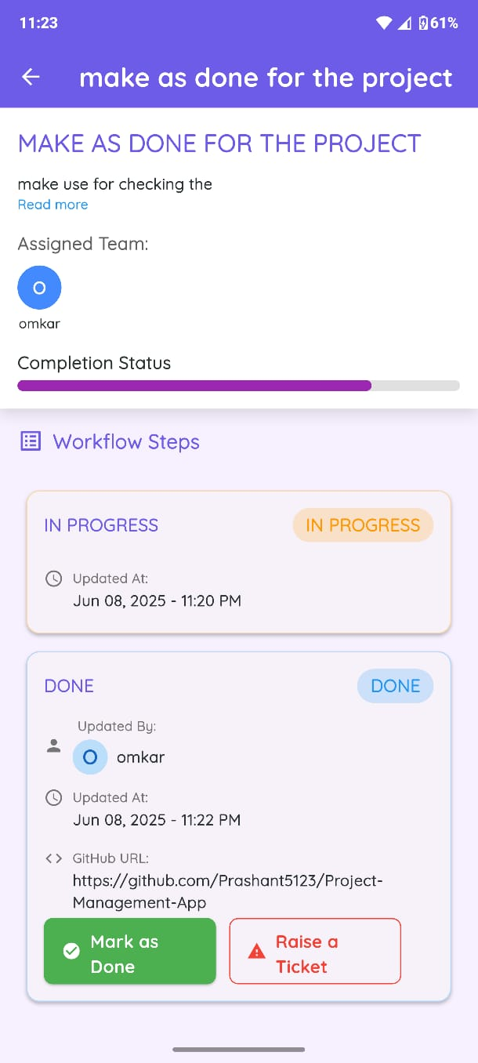
Real-Time Tracking: Monitoring Project Progress and Status
1
Task Completion Status
The application tracks the completion status of each task, providing real-time updates to the team lead and manager.
2
Progress Visualization
The application provides a visual representation of project progress, including charts, graphs, and timelines, to provide a clear overview of the project status.
3
Communication Channels
The application facilitates communication within the team through integrated chat, message boards, and notification systems, ensuring everyone is informed and aligned.

Slide 14
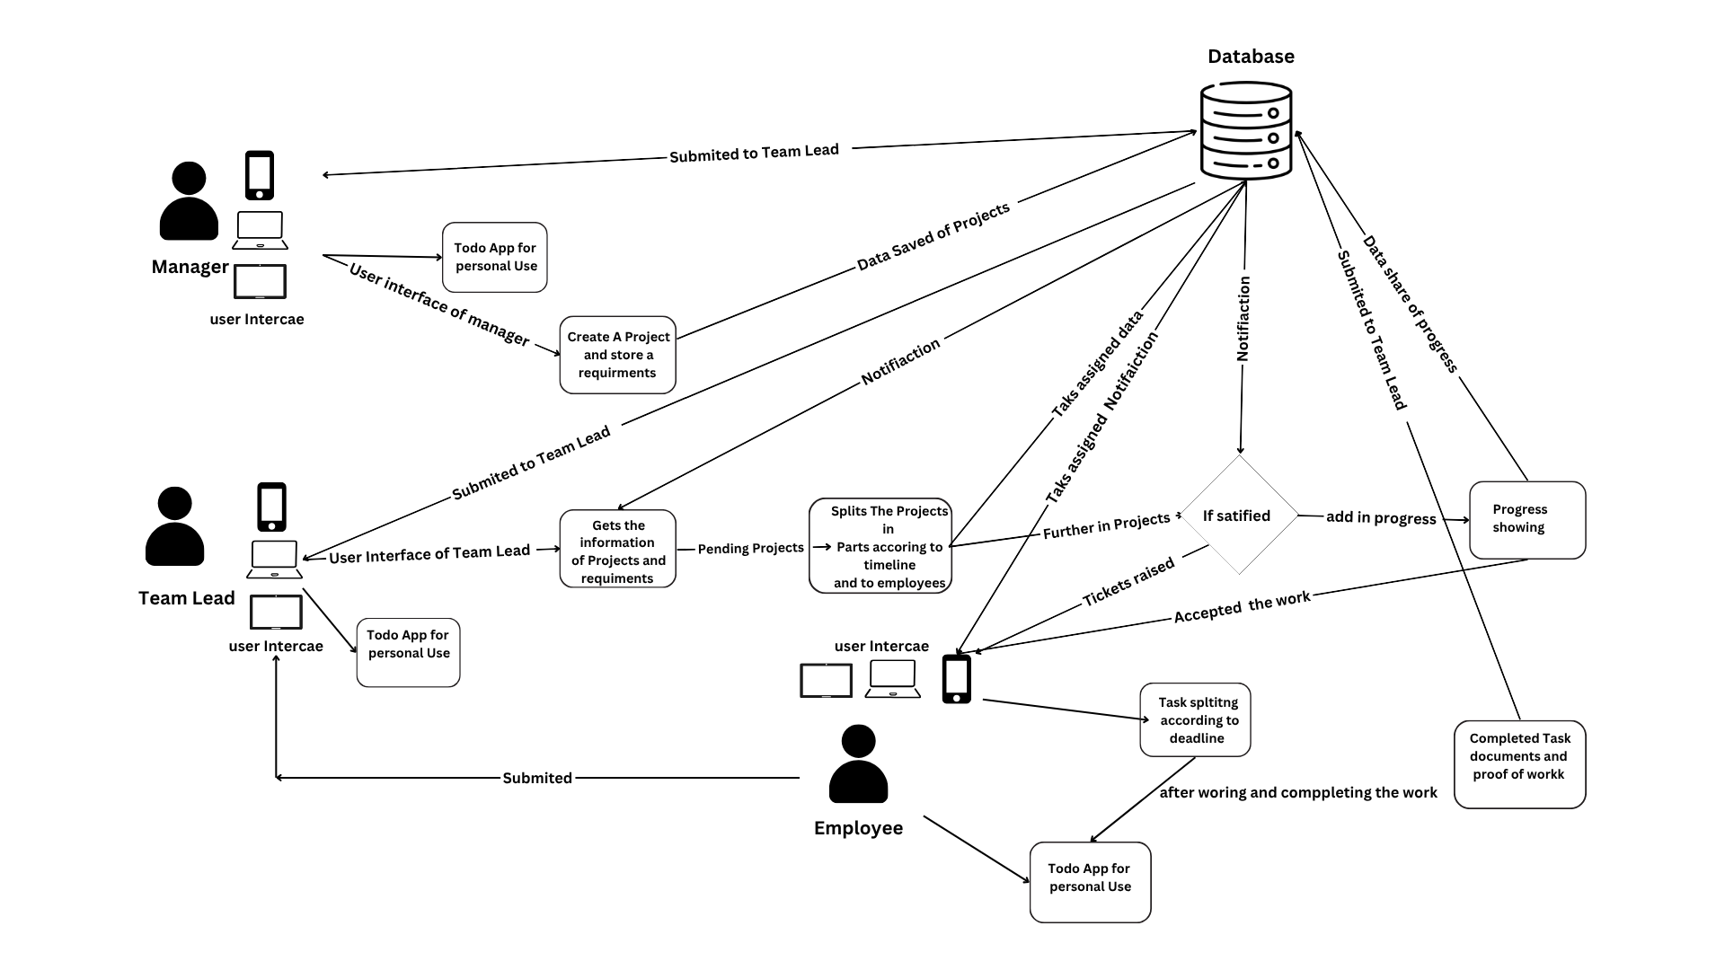
System Architecture

Slide 15
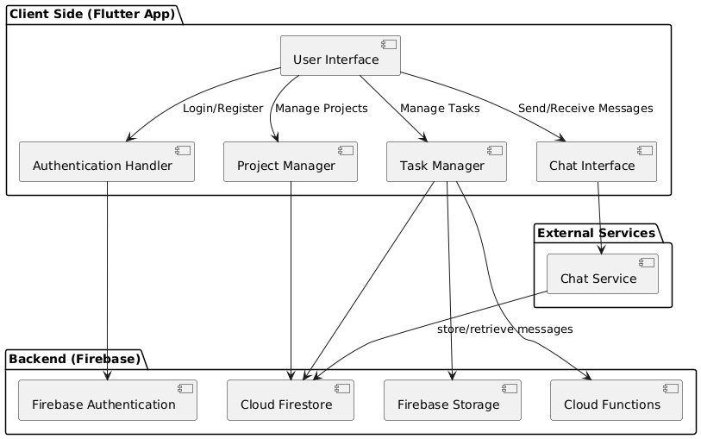
UML Diagram :

Slide 16
Benefits of the Cross-Platform Application
Improved Communication
The application promotes clear and timely communication, reducing misunderstandings and improving collaboration between team members.
Increased Efficiency
The application streamlines workflows and task management, eliminating unnecessary steps and saving valuable time and resources.
Enhanced Collaboration
The application fosters a collaborative environment, enabling team members to share ideas, feedback, and updates effortlessly.
Improved Project Visibility
The application provides real-time project progress and status updates, giving everyone a clear understanding of the project's health and any potential roadblocks.

Slide 17
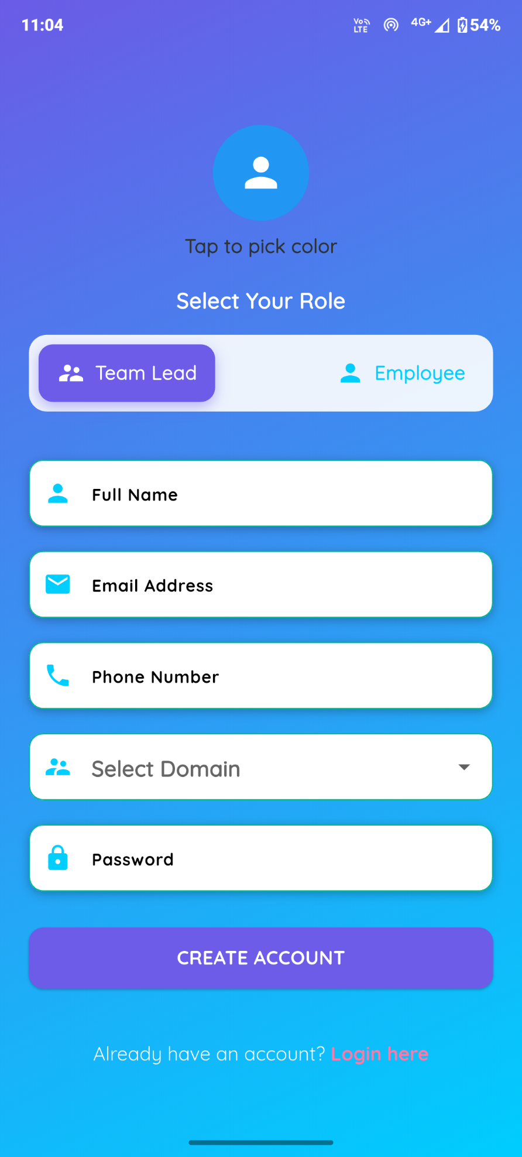
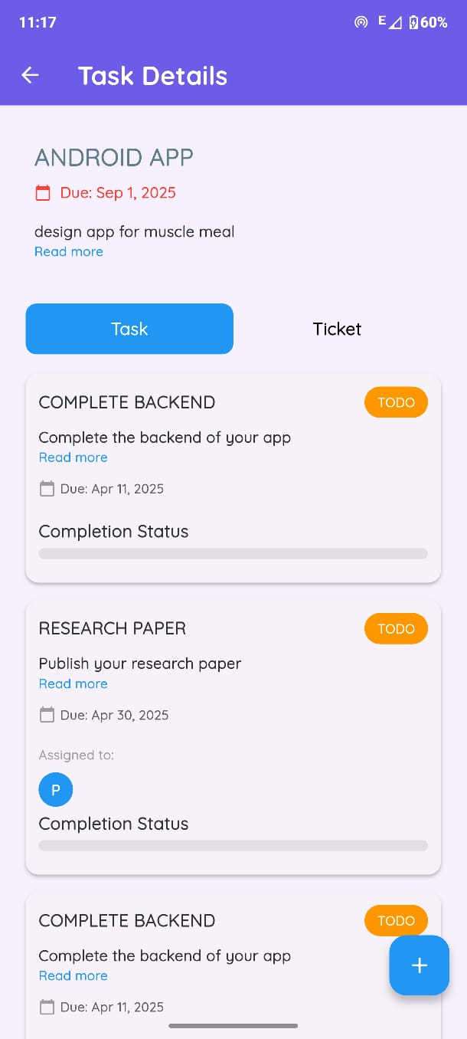
Key Features of the Application
1
Task Management
The application allows for detailed task creation, assignment, and tracking, with clear deadlines and progress updates.
2
Project Planning
The application enables project planning, including setting milestones, defining dependencies, and managing resources.
3
Collaboration Tools
The application provides various collaboration tools, such as chat, message boards, file sharing, and project documentation.
4
Reporting and Analytics
The application generates comprehensive reports and analytics to track project progress, identify areas for improvement, and make informed decisions.

Slide 18
Limitations
Development Challenges Integration Complexity: Implementing VPN and Web3Auth might require advanced backend and security expertise. Time-Intensive: Adding robust security features can delay development timelines.
Performance Issues VPN Dependency: Requiring a VPN might slow down app performance or create issues for users in areas with restricted VPN access. Resource-Intensive: Web3Auth and VPN integration could increase the app's memory and processing requirements.
User Accessibility Steep Learning Curve: Users unfamiliar with VPNs or Web3Auth may find it difficult to set up and use. Compatibility: Ensuring smooth functionality across various devices and platforms can be challenging.
Market Adaptation Niche Audience: High security may appeal only to specific industries, potentially limiting your audience. Competition: Many task management apps already dominate the market, making differentiation harder.
Cost Constraints Infrastructure Costs: Running secure servers and managing VPN infrastructure might increase operational expenses. User Costs: If a VPN is required, users might need a paid subscription, which could deter adoption.

Slide 19
Future Plans
Phases of the project Create a visual roadmap with milestones to show your app's progress and future plans. Example: Phase 1 (20% UI): Basic design and navigation using Flutter. Phase 2: Add task management features and basic communication. Phase 3: Implement "Run on only VPN" for secure access. Phase 4: Add Web3Auth for decentralized authentication.
Highlight Planned Features Prepare a simple “Upcoming Features” slide or section: "End-to-end secure communication with VPN.“ "Decentralized login using Web3Auth for better data control.“ "Enhanced team collaboration features with analytics.“
Mockup Key Features Create mockups for how the app will look or function with VPN and Web3Auth.Use tools
like Figma for interactive designs if possible.
Version Release Plan Present a version-based plan: Version 1.0: UI + basic functionality. Version 2.0: Security enhancements with VPN and Web3Auth.
Interactive Demo or Prototype Use the 20% UI you’ve built to showcase the current functionality. Add
placeholders like "Secure with VPN – Coming Soon" or "Web3Auth Login – In Development."

Slide 20




Conclusion: A Powerful Tool for Project Success
Streamlined Workflow
The application simplifies project management, eliminating inefficiencies and ensuring smooth operations.
1
Enhanced Communication
The application fosters clear and effective communication, promoting collaboration and reducing misunderstandings.
2
Improved Productivity
The application empowers team members to work more efficiently and effectively, achieving project goals within deadlines.
3
Greater Project Success
By combining these benefits, the application contributes significantly to
increased project success rates.
4

Slide 21
References
P. Appandairajan, Z. Ali Khan, and M. Madiajagan, “ERP on Cloud: Implementation Strategies and Challenges,” Dept.
of Computer Science, Birla Institute of Technology & Science, Pilani, Dubai Campus, Dubai, UAE. 2012.
S.Tongsuksai, S. Mathrani, and N. Taskin, “Cloud Enterprise Resource Planning Implementation: A Systematic
Literature Review of Critical Success Factors,” School of Food and Advanced Technology, Massey University, Auckland,
New Zealand. August 13,2020
T. Mladenova, “Open-source ERP systems: an overview,” Department of Computer Systems and Technologies,
University of Ruse, Ruse, Bulgaria. May 20,2021.
S. Tongsuksai, and S. Mathrani, “Integrating Cloud ERP Systems with New Technologies Based on Industry 4.0: A Systematic Literature Review,” School of Food and Advanced Technology, Massey University, Auckland, New Zealand. June 03,2021.
M. Mokar et al., “Communication Technologies in CloudBased ERP,” Institute of Computing, University of
Technology.2021.
Z. Ali Khan et al., “Challenges in Implementing CloudBased ERP Systems,” Journal of Information Systems and
Technology 2022.

Slide 22
Mohamed Mokar, Sallam Fageeri, Sai Fattoh, “Using Firebase Cloud Messaging to Control Mobile Applications”, 2019
International Conference on Computer, Control, Electrical and Electronics Engineering, May 05,2020.
S. Jain and K. Chandrasekaran, “Industrial Automation Using Internet of Things,” in Security and Privacy Issues in
Sensor Networks and IoT, IGI Global, 2020, pp. 28–64.
N. Chatterjee, S. Chakraborty, A. Decosta, and A. Nath, "Real time Communication Application Based on Android Using Google Firebase," Int. J. Adv. Res. Comput. Sci. Manag. Stud, 2018.
A. Rahmi, I. N. Piarsa, and P. W. Buana, "FinDoctor Interactive Android Clinic Geographical Information System Using
Firebase and Google Maps API," International Journal of New Technologyand Research, vol. 3, 2017.

Slide 23
THANK YOU

